Slide 1

Deep learning for analysing immune cell interactions
Level 4 Honours Project – Leonore Papaloizos
Notes:
Hi, today I’m going to talk about my honours research project. My project was deep learning for analysing immune cell interactions. I researched deep learning methods as a way of analysing interactions between immune cells.

Slide 2
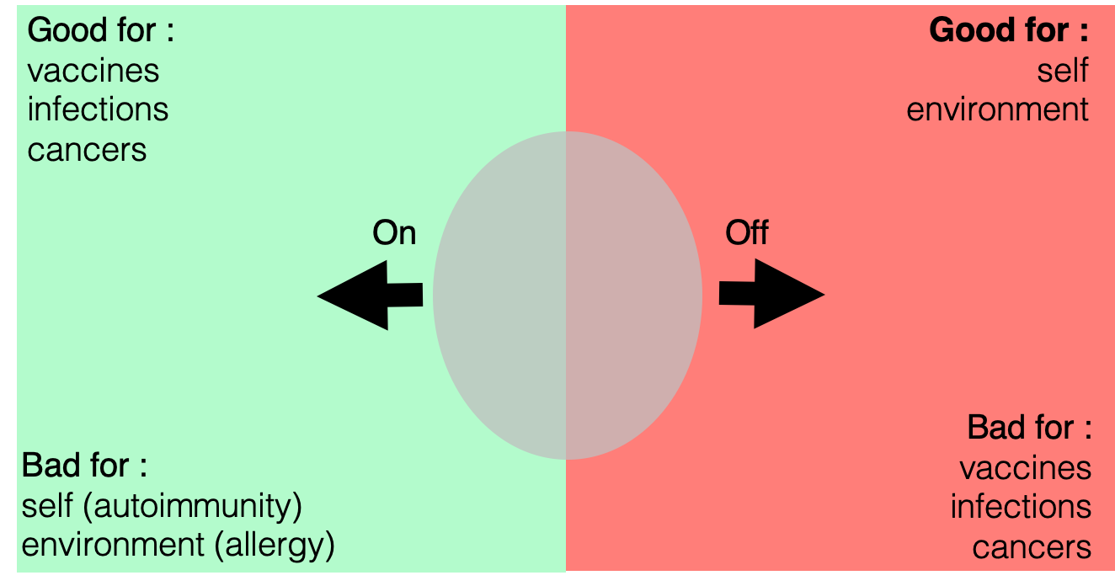
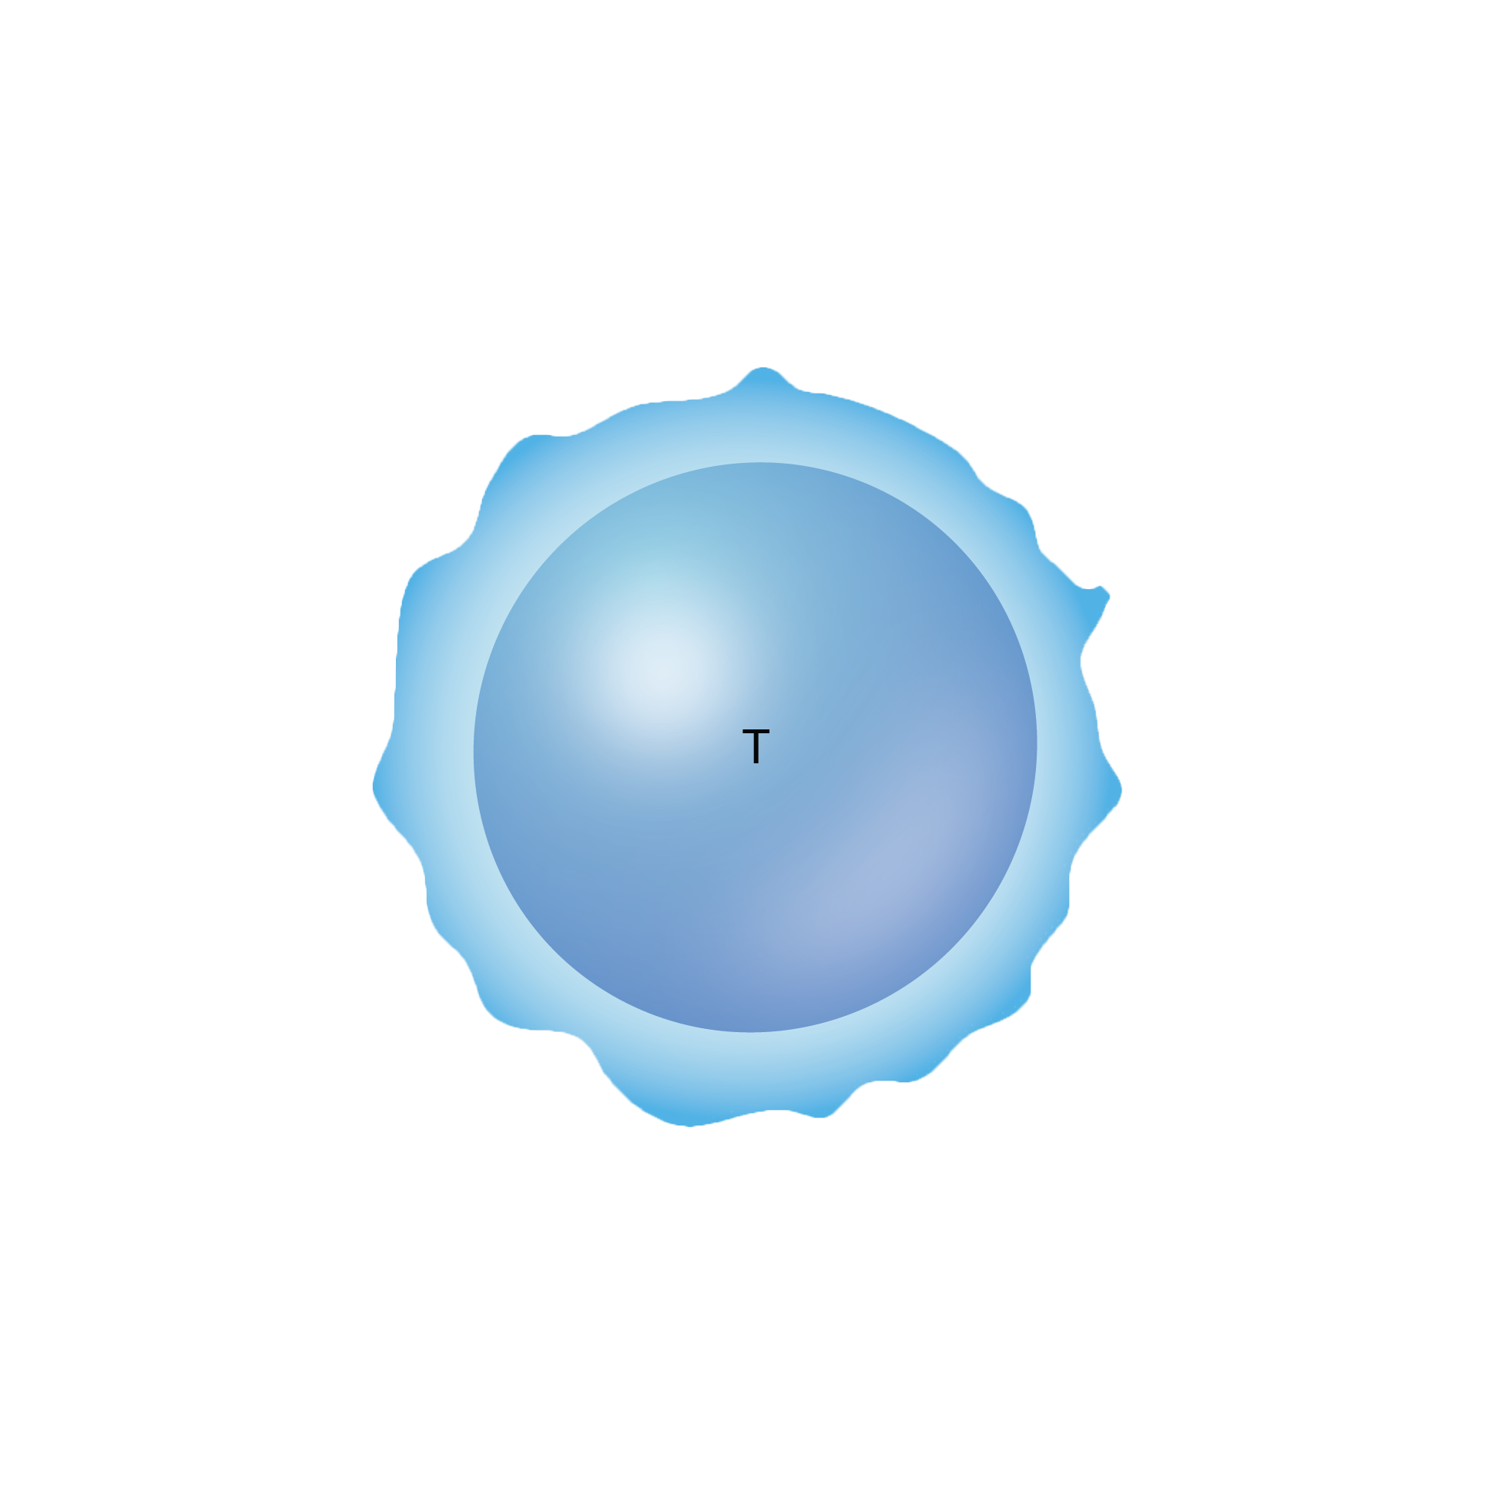
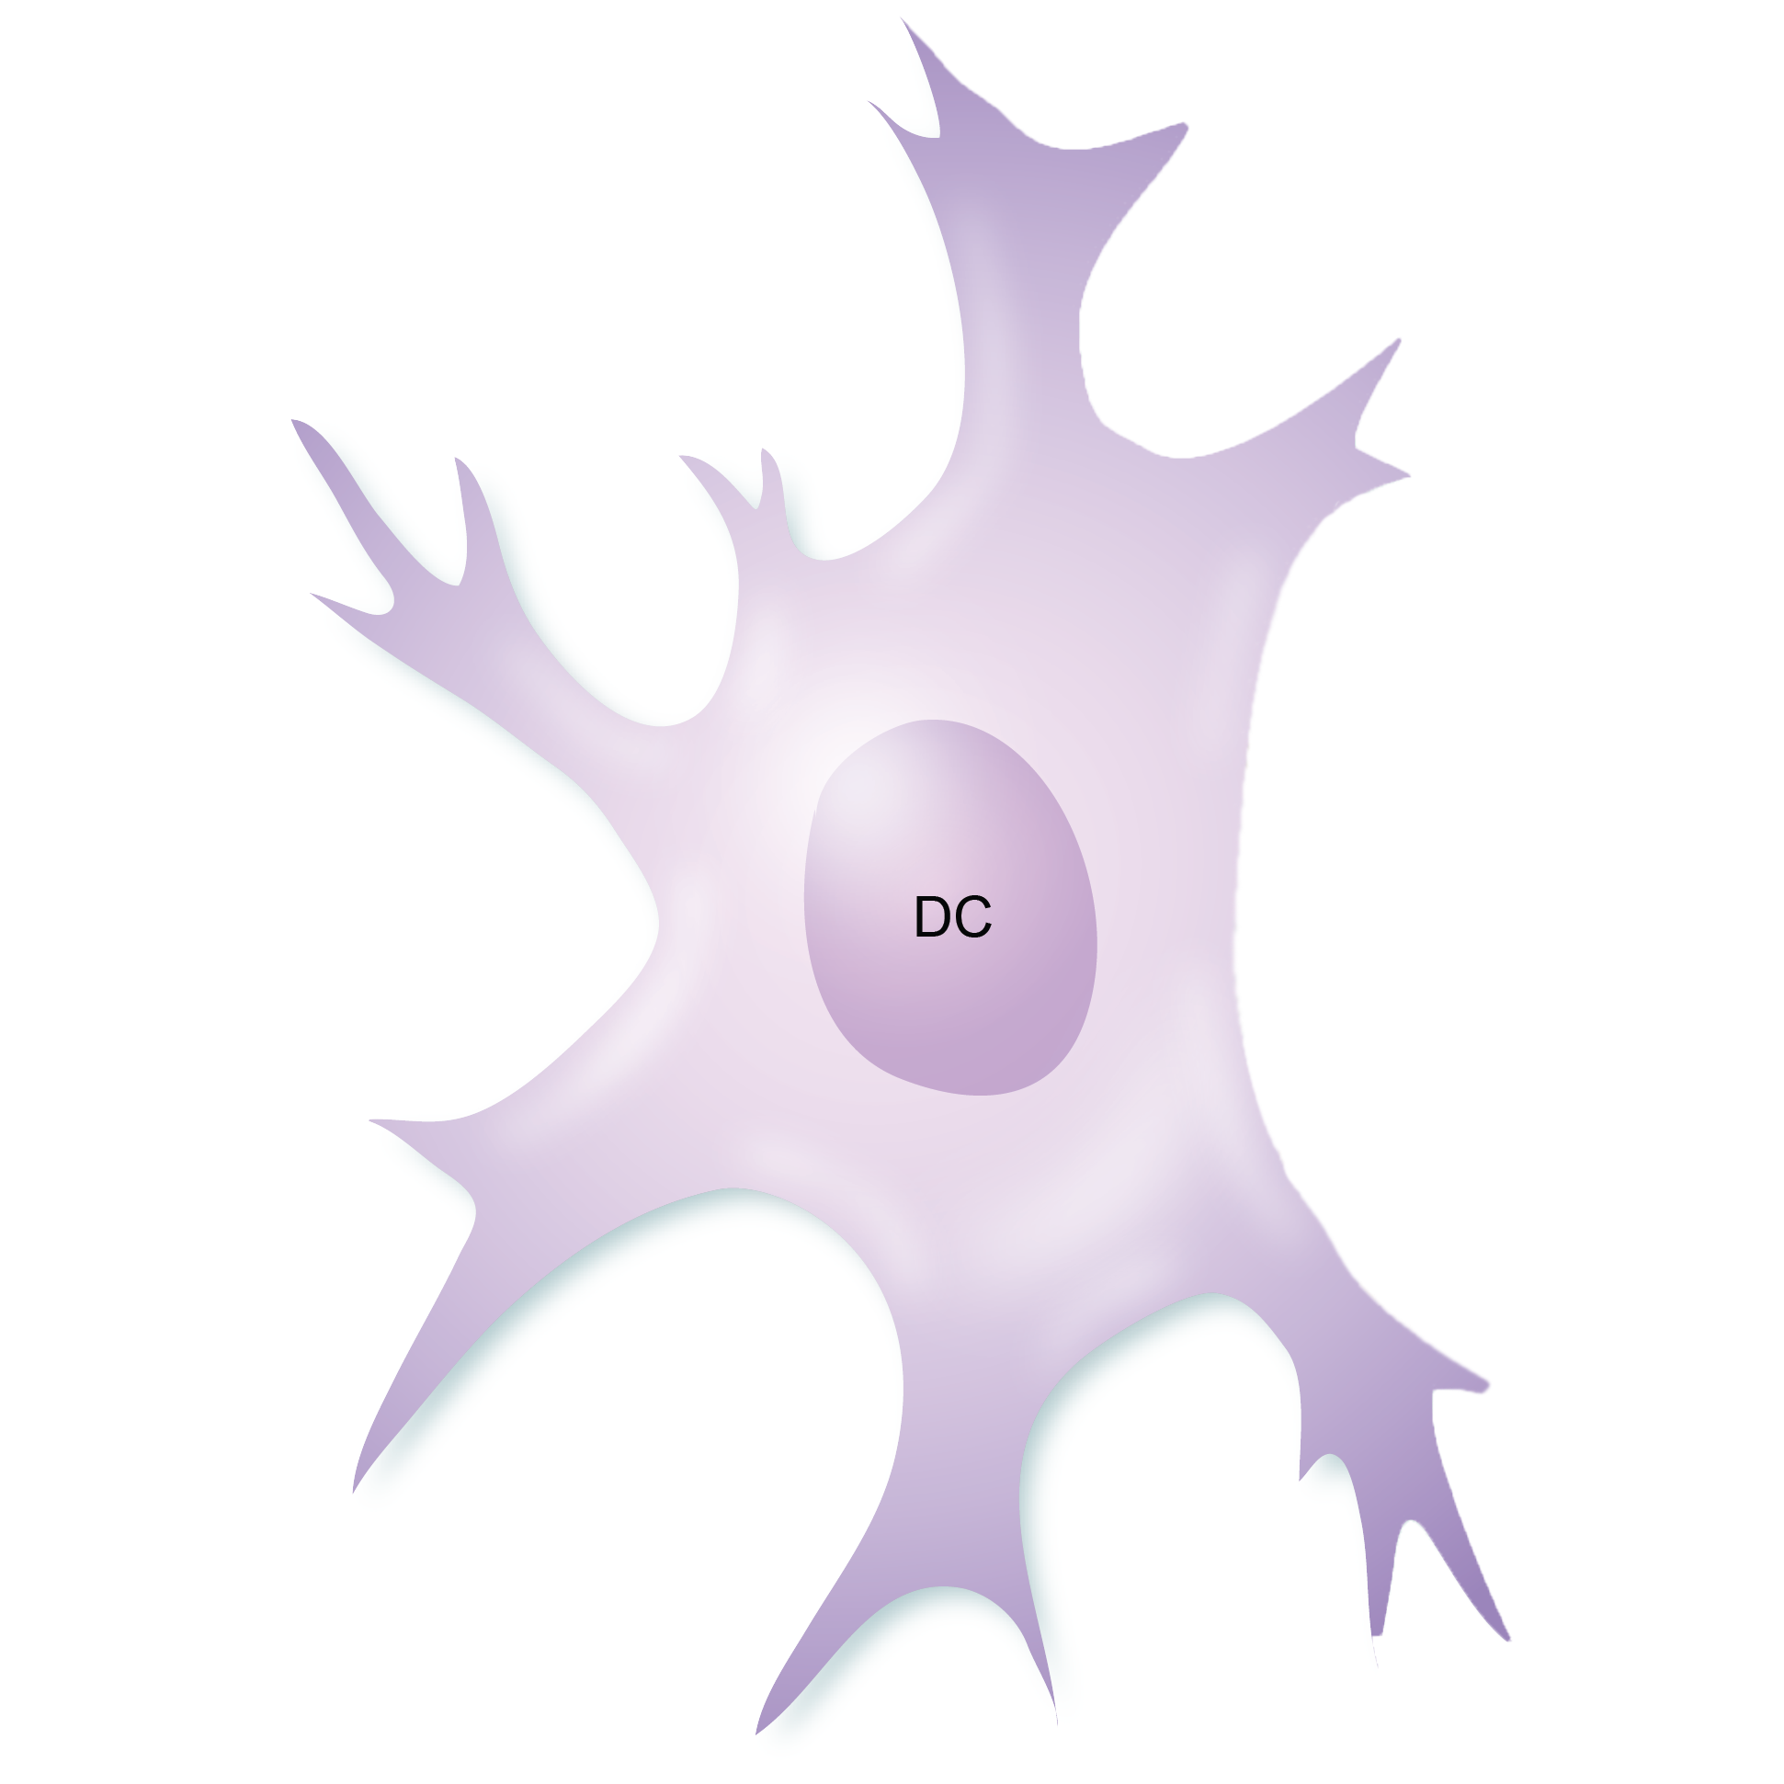

Motivation
Let’s talk about our immune system!
Notes:
To talk about the motivation for the project, I need to go into some immunology background. So let’s talk about our immune system.
Our immune system is our protective shield against pathogens. It functions by discriminating between what is part of our self, and what isn’t, and fighting what is alien to it. You can picture it as a speed date. Our immune cells go on quick date with each other, and depending on how much they are compatible, they will generate a positive reaction, so an immune reaction, or a negative reaction → either a lack of reaction or an attack against itself.
Like on a date, the interactions between immune cells can be enhanced by the use of foreign substances -- drugs. Studying the reactions of immune cells under the influence of different types of drugs is key to the development of drugs for diseases such as viral infections, cancer or auto-immune diseases. So this is why studying immune cell interactions is interesting.
The immune cells we are interested in in this case are T-cells (in blue), and Dendritic cells (in purple). The interaction between T-cells and dendritic cells is key in generating the antibodies we need to fight dangerous substances such as viruses.

Slide 3
How can the interaction between immune cells be analysed with deep learning?
We have a large amount of imaging data available
High-dimensional
Previous research has shown neural networks are efficient in processing images
Recent advances have successfully applied deep learning to cancer research
We want to explore the use of autoencoders for analysing these images
Unsupervised learning → visualisation of the data in 2D plane
Building block for supervised learning → regression
Notes:
We want to apply deep learning to this immunology context because studying immune cells could be particularly studied to deep learning
The reactions are often studied through pictures of immune cells by immunology researchers. They have provided us with a large amount of high-dimensional data
Previous research has shown neural networks are efficient in processing images: recent advances have successfully applied deep learning to cancer research
We want to explore the use of autoencoders for analysing these images
An autoencoder is a type of neural network with a symmetrical inner structure which is trained to map its input to its output while reducing the dimensions from the input. The idea is to obtain a smaller representation of the input that can be efficiently reconstructed.
This would gives us two parts to our research:
Unsupervised learning → visualisation of the data in 2D plane with the UMAP visualisation technique
Building block for supervised learning → regression model

Slide 4
What are the aims of this research?
Is there an underlying structure in images of immune cells under different experimental conditions?
Can we quantify interaction from an image of immune cells?
Notes:
These were the aims of our experiments:
Is there an underlying structure in images of immune cells under different experimental conditions?
→ autoencoder + visualisation technique can help us with that
can we quantify interaction between cells from an image of immune cells?
we can do this with a deep regression model

Slide 5
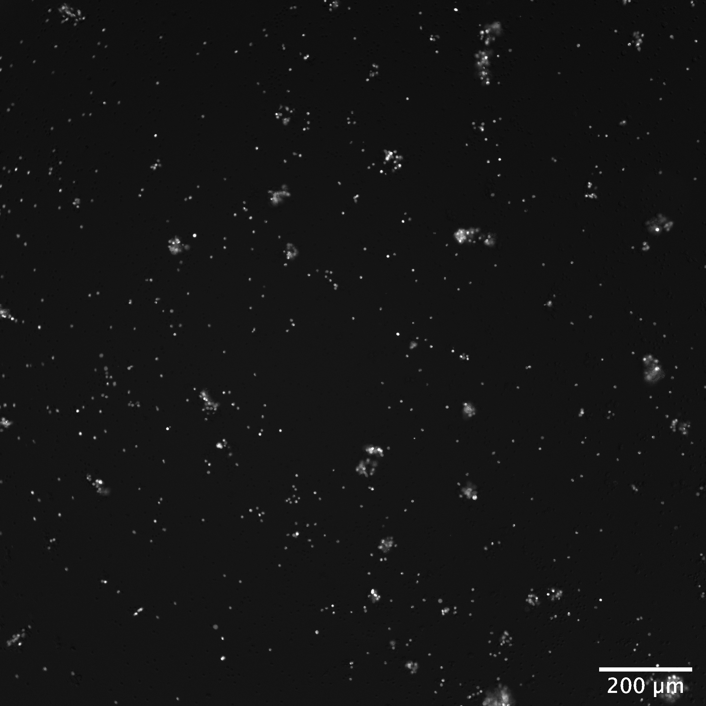
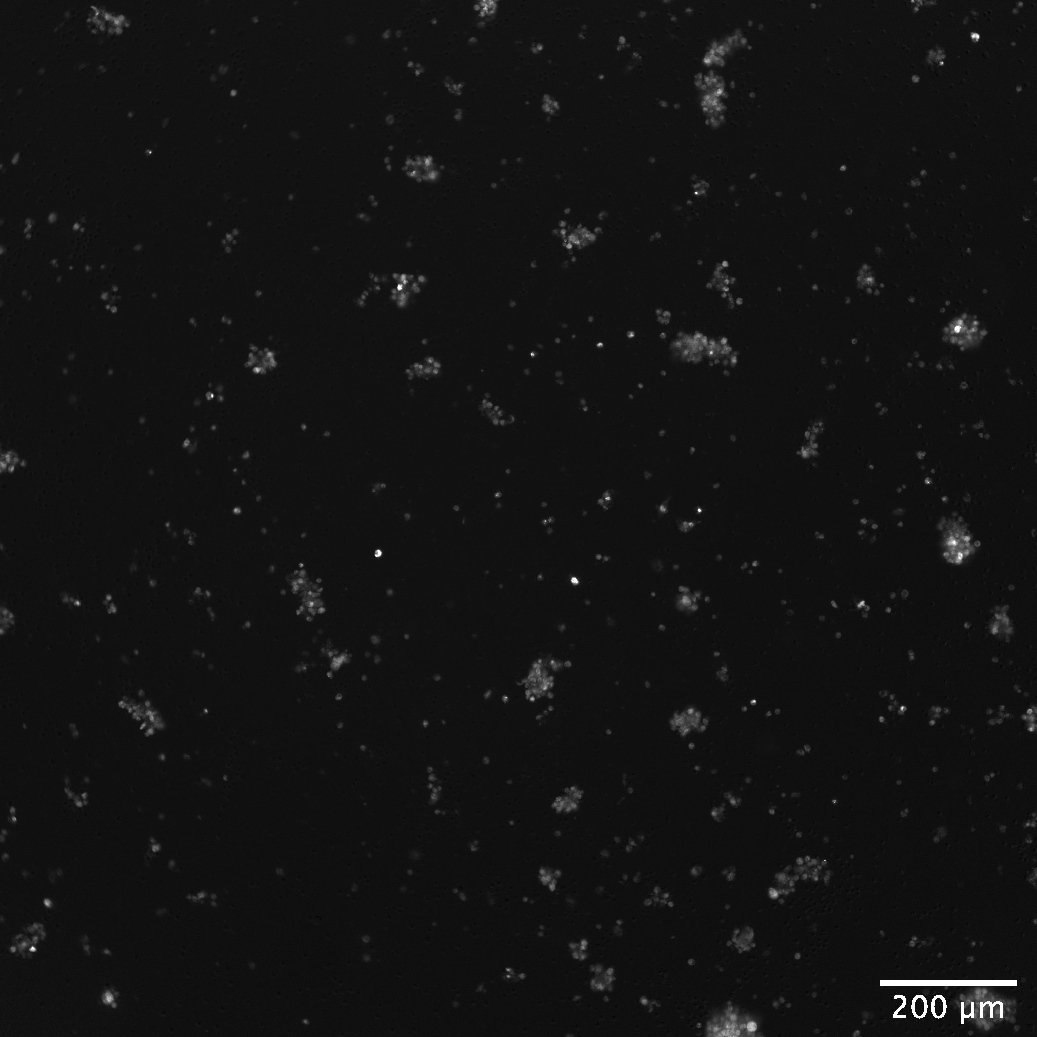
Illustration
Notes:
To illustrate, these are some raw images of immune cells we were provided. we have T-cells in a well on the left, and dendritic cells in a well on the right. both the images were taken from the same setup, but we have a separate picture for each because the cells were loaded with different fluorescent dyes.

Slide 6
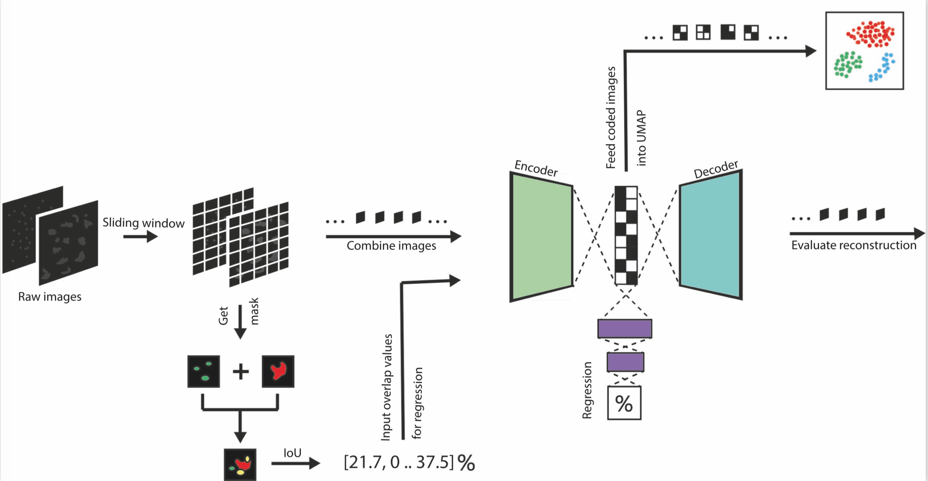
What was build?
Notes:
So what did I build? I will walk through this system diagram.
We took the raw pictures of immune cells and created a dataset from sub-images by passing a sliding window over the images. This allowed us to get more detail from the image as well as create a bigger dataset. From the images shown in the previous slide we can see two issues:
1/ whole image on its own is too big, too much memory
2/ cant see the cells clearly, theyre too small
We then combined the images into a RGB image so that the cells could be seen on the same plane together.
First this dataset was used on its own for training an autoencoder in unsupervised learning. I took the coded representations of the images from the bottleneck of the network and used UMAP to project this data onto a two-dimensional plane to evaluate whether or not there was an underlying structure in the data.
Then in a second development effort, I developed a regression model that would predict an ‘interaction measure’ from the images of immune cells. The idea was that ‘interaction’ would be defined as immune cells overlapping in our images. We obtained an ‘interaction metric’ by segmenting the images and calculating the intersection-over-union of the binary masks obtained in order to get a % of overlap between the immune cells.
These metrics were fed alongside the images to a regression model that was built on top of the autoencoder. The aim was to train the regression model for it to be able to predict a quantity of interaction in unseen images.

Slide 7
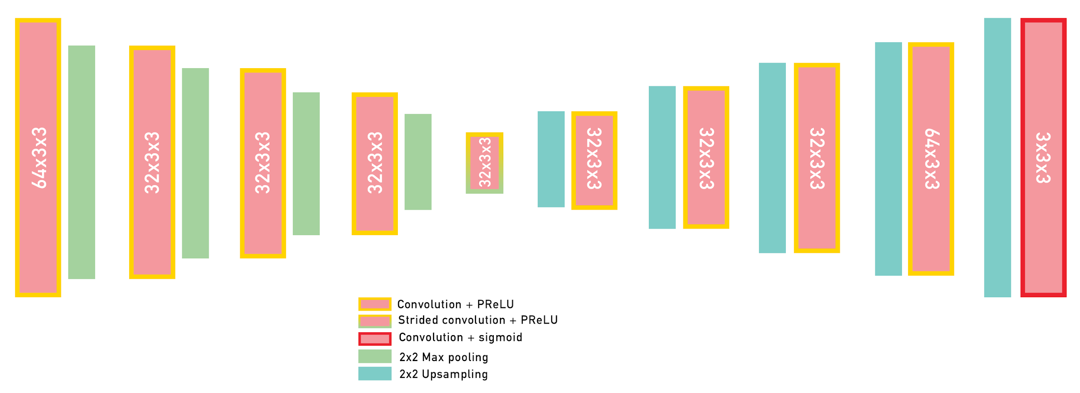
What is the structure of the autoencoder?
Notes:
I will now go over some implementation specifics.
This diagram shows the structure of the autoencoder. We built a convolutional autoencoder as we were dealing with images. We reduce the image dimensions a total of 5 times to reduce the original dimensions tenfold. We used a traditional structure of convolution + parametric relu activation accompanied by pooling operations.

Slide 8
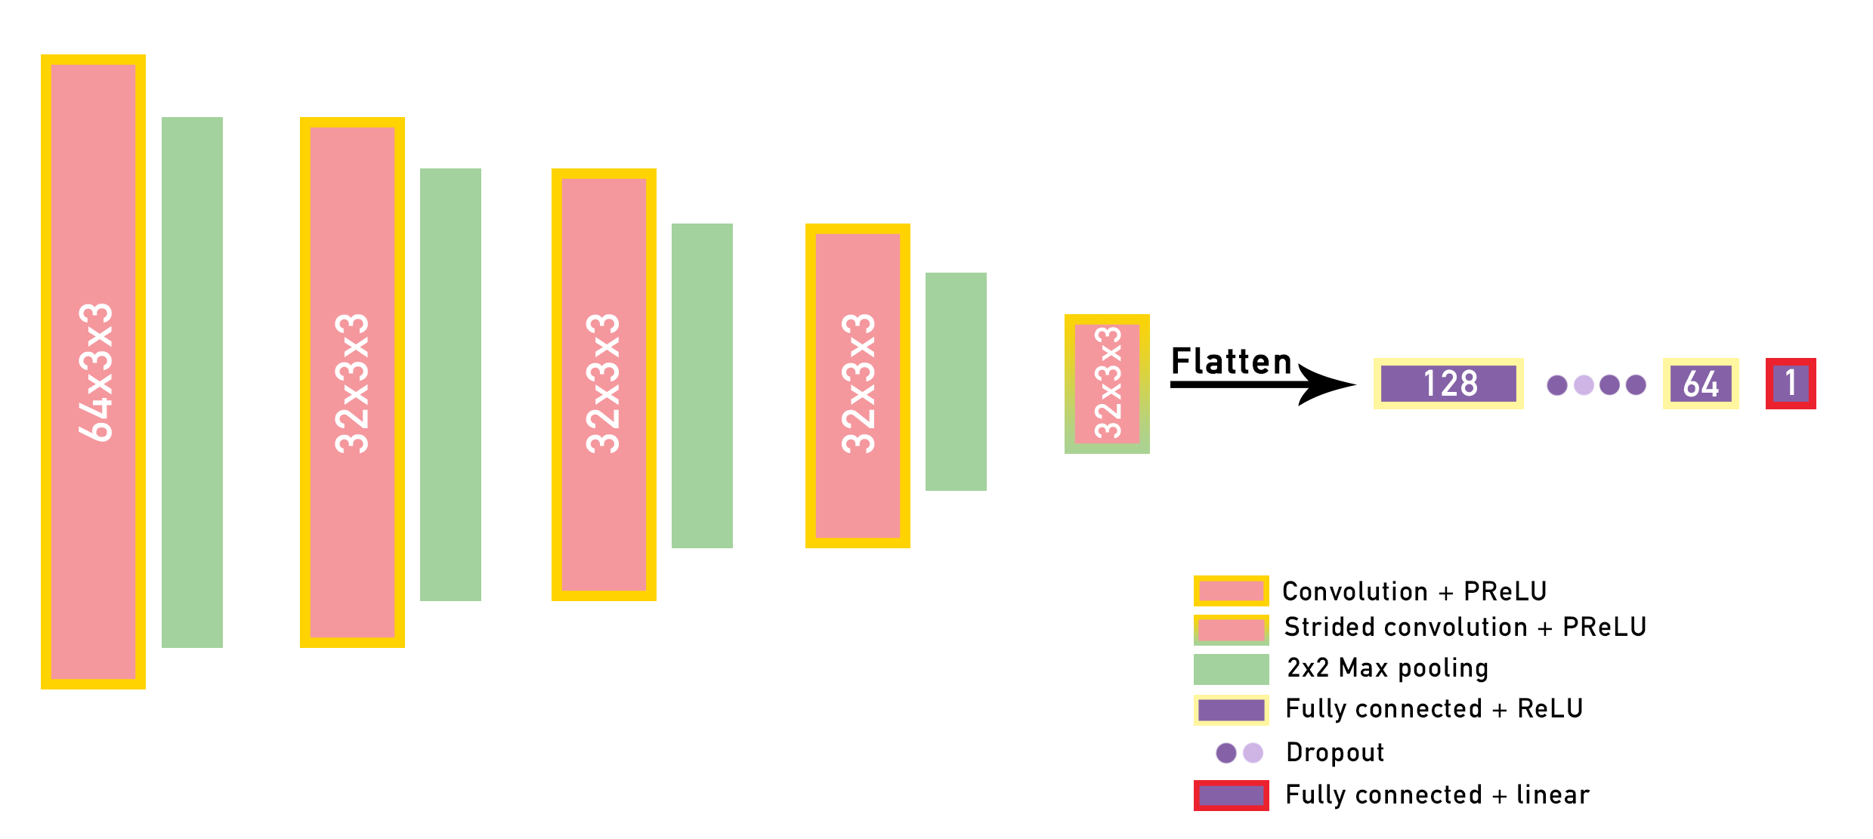
What is the structure of the regression model?
Notes:
From this autoencoder we built a regression model. We kept it quite simple. The first part of the model is the same as the first part of the autoencoder as you can see. We then use two fully connected layers separated by dropout to build a robust prediction. we use a linear activation in our final layer, but it is constrained in the kernel so it does not output negative values.

Slide 9
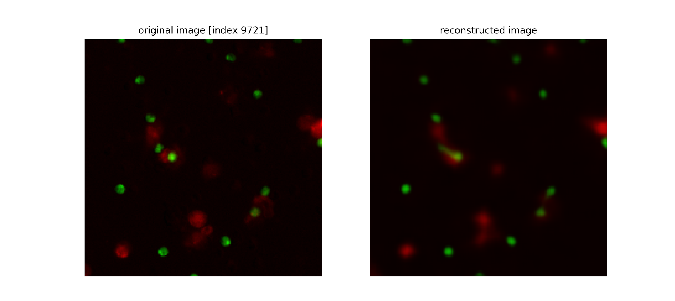
How well can we reconstruct images with an autoencoder?
Notes:
I will know talk about the results of our experiments. As we can see autoencoder reconstruction performance is pretty good, considering the image on the left is made of 110,592 pixels and the image on the right was reconstructed from a representation of that image made of a thousand pixels.

Slide 10
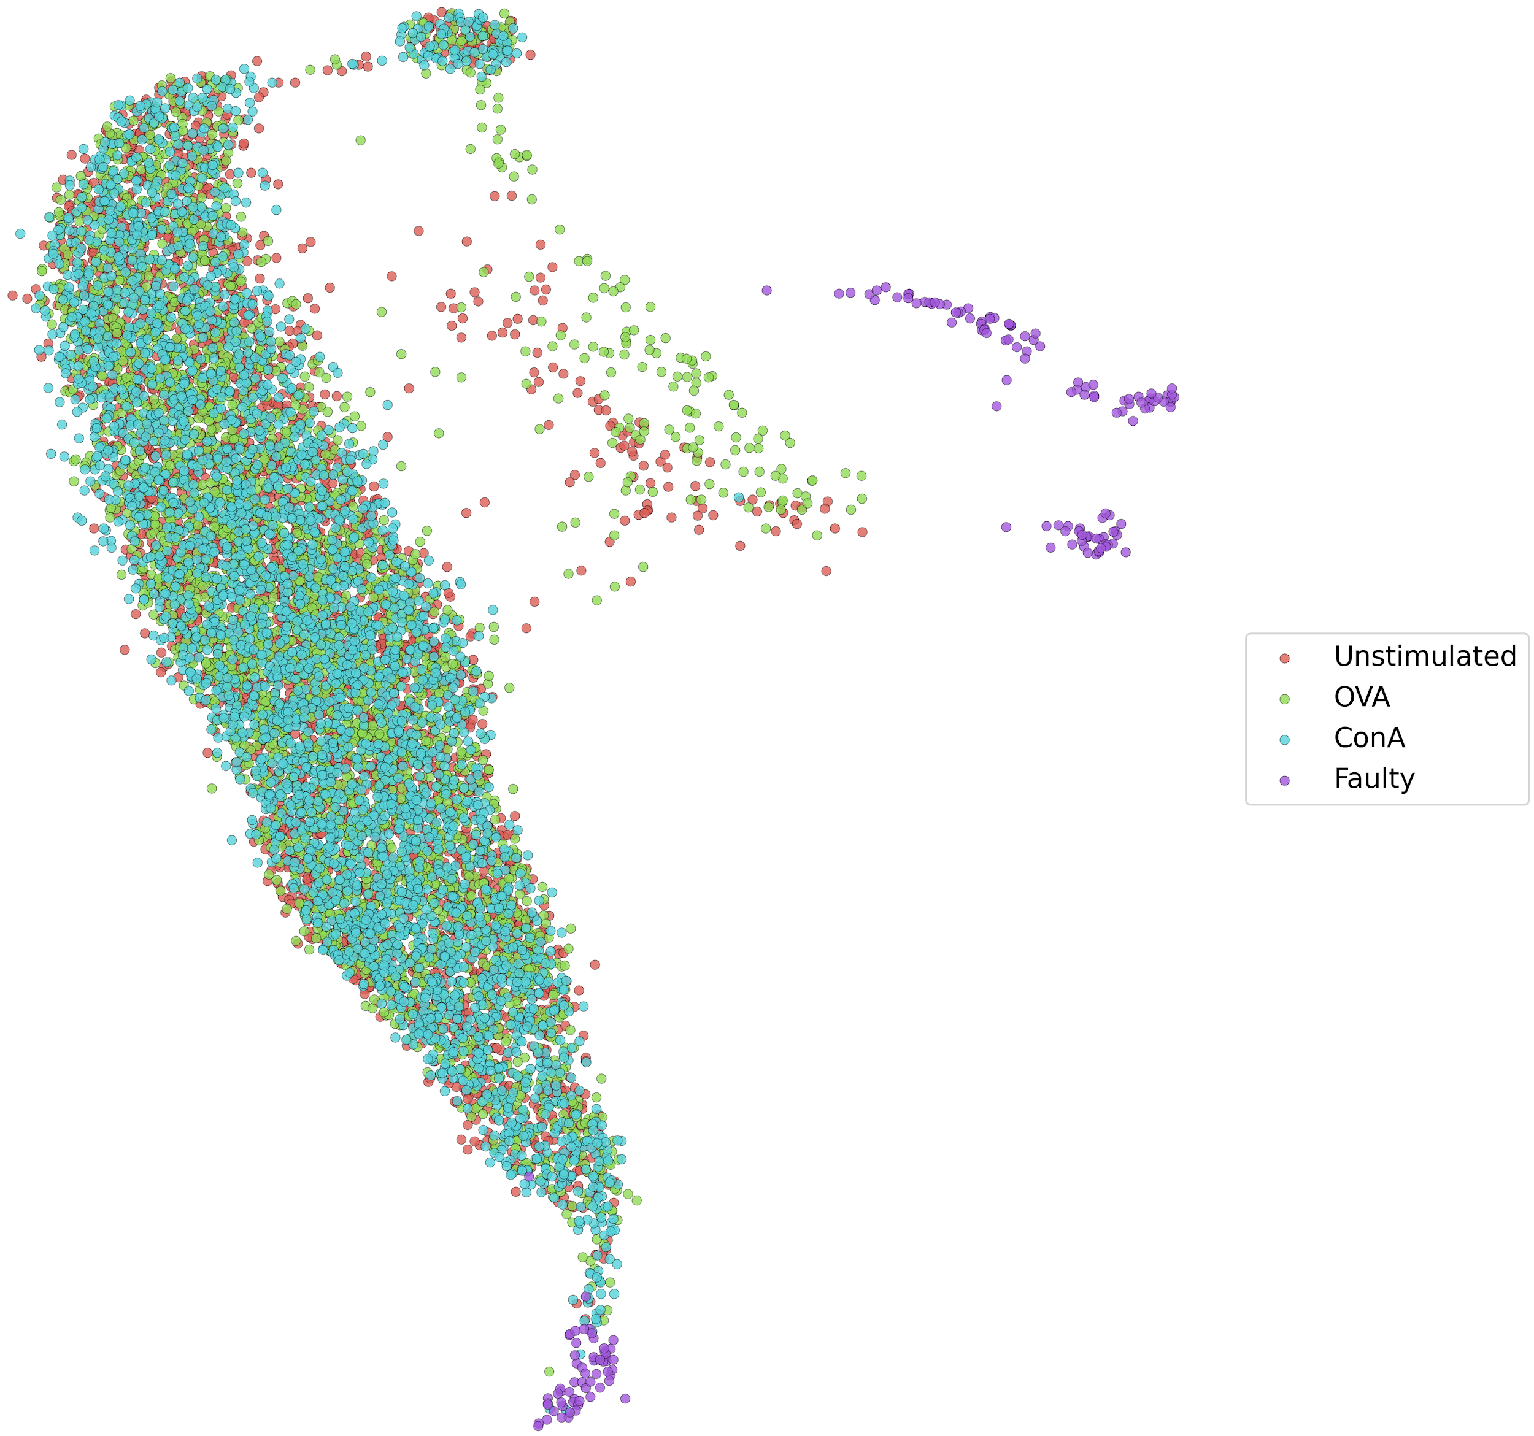
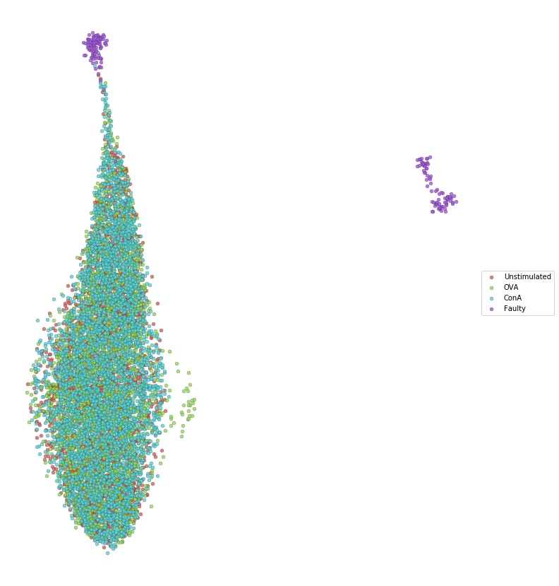
Can we find an underlying structure in the images of immune cells?
← non-reduced
reduced →
Notes:
Now to answer the question: can we find an underlying structure in the images of immune cells?
For this we needed to compare it to a baseline performance. The image on the left is UMAP ran on the images before they have been reduced in dimensions. The image on the right is after. We were expecting 3 clusters but did not really achieve that.

Slide 11
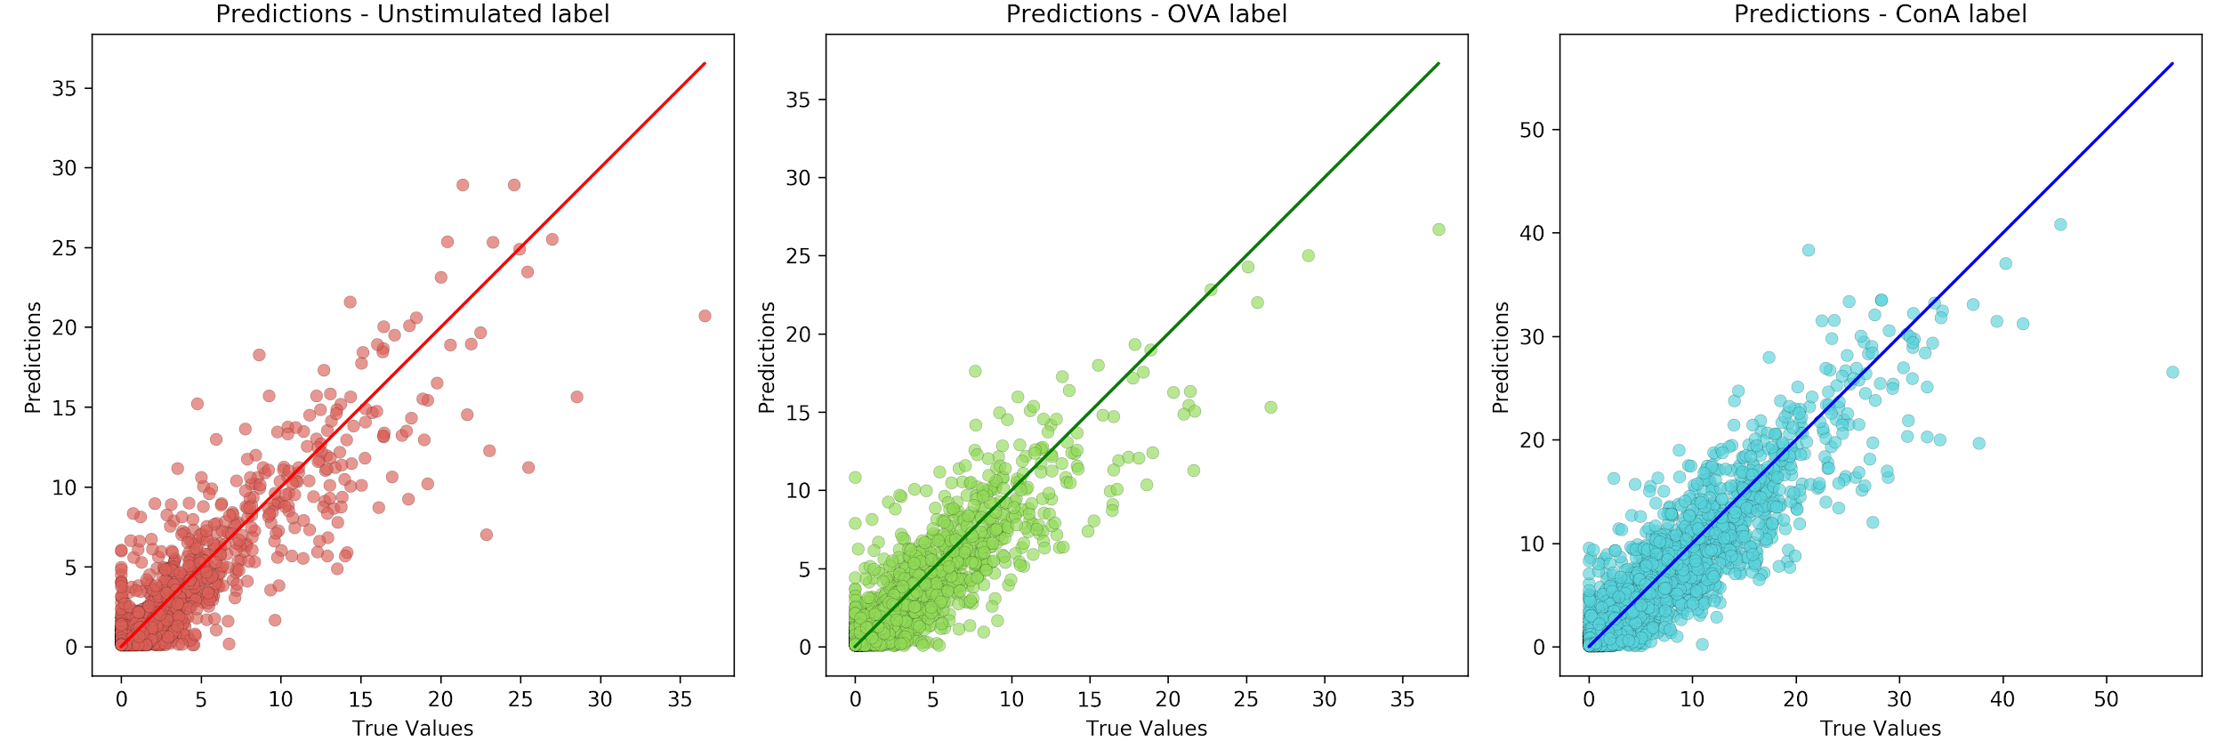
Can we quantify interaction in unseen images of immune cells?
RMSE score: 1.838, SD 4.583 (true SD: 4.853)
Notes:
And for our other question, can we quantify interaction in unseen images of immune cells? The answer seems to be yes. The graph here shows a plot of the lines of best fit for our predicted values compared to our true values. So if the predicted value is close to the true value it should lie in the diagonal. There are some errors but overall we got a RMSE score of 1.838.

Slide 12
Summary
Is there an underlying structure in images of immune cells under different experimental conditions? → maybe...
Can we quantify interaction from an image of immune cells? → yes
Notes:
I had two aims to my research: answering these questions.
Have I found an underlying structure in images? it does not seem so, but this could be down to multiple factors. it could be that we picked too small of a window size which gave us too much of a local view and not global enough. it could also be that there are too many experimental conditions behind each image, so datasets should be carefully curated. however autoencoders work on this data and are a good founding block for working with high dimensional images
Was I able to quantify interaction from these images? Yes. RMSE score for our regression model was low. The autoencoder dimensionality reduction worked well.
Of course our regression model is limited by the metric it uses. other metrics could be crafted to best suit the task, to account for things like agglomeration of cells around another (without overlap).
To conclude, Immunology research is important for us to better understand our immune system and how to protect ourselves from alien forces like viruses.
There seems to be a gap in research in applying deep learning to the analysis of images of immune cells, even though closely related fields, for example cancer research has shown successful results for detecting cancer through deep learning techniques.
We have shown that deep learning shows promise in the context of analysing immune cell interactions by developing an autoencoder and a deep regression model on top of that autoencoder.
The research that has been conducted here only represents a sub-division of what could be possible with deep learning. Future work could include looking at the morphology of cells using deep segmentation models, or developing other interaction metrics.

